Slide 1
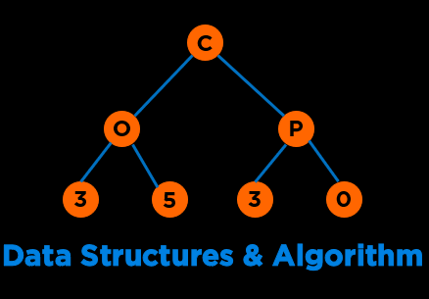
Final Exam Review
Notes:
Hi everyone, welcome to the second module of the course

Slide 2
Categories of Data Structures
Linear Ordered
Non-linear Ordered
Not Ordered
Lists
Trees
Sets
Stacks
Graphs
Tables/Maps
Queues
Notes:
Data structures are ways to collect data. There are basic categories of data structures:

Slide 3
Announcements
You must take the exam between Thursday, Nov 21, 1 pm to 5 pm EST. This means you must start by 3 pm EST or else you will lose time.
The exam will be over Honorlock and you are allowed one double sided handwritten sheet of notes.
The exam duration is 2 hours.
Exam 2 Topics and Expectations Guide: Link
Exam reviews: https://ufl.instructure.com/courses/515376/pages/module-13-review-and-exam-2
Notes:
Discussed, touched upon, went over, covered
Emerges out of the limitations offered by our second approach

Slide 4
Mini Review – Linked Lists
Consider a class List that implements an ordered list backed by a singly linked list with a head pointer. The invariant “ordered” is maintained always. Given that representation, what is the worst-case time complexity of the following operations? Assume the list is sorted in ascending order.
A. Insert an item
B. Finding the minimum element
C. Delete the largest element from list
D. Finding the largest element
E. Finding a random element, n
F. Deleting the minimum element in the list
Notes:
Psuedocode and code

Slide 5
Mini Review – Linked Lists
Consider a class List that implements an ordered list backed by a singly linked list with a head pointer. The invariant “ordered” is maintained always. Given that representation, what is the worst-case time complexity of the following operations? Assume the list is sorted in ascending order.
A. Insert an item : O(n)
B. Finding the minimum element : O(1)
C. Delete the largest element from list : O(n)
D. Finding the largest element : O(n)
E. Finding a random element, n : O(n)
F. Deleting the minimum element in the list : O(1)
Notes:
Psuedocode and code

Slide 6
Mini Review – Stacks
Worst case time complexity for an array-based queue for following operations:
enqueue()
dequeue()
isEmpty()
top()
Notes:
Psuedocode and code

Slide 7
Mini Review – Stacks
Worst case time complexity for an array-based queue for following operations:
enqueue() – O(1)
dequeue() – O(1)
isEmpty() – O(1)
top() – O(1)
Notes:
Psuedocode and code

Slide 8
Mini Review – Lists
What is the output of the following code:
#include <iostream>
#include <list>
int main ()
{
std::list<int> mylist = {34, 77, 16, 2};
std::cout << "List contains: ";
auto it = mylist.end();
while(it != mylist.begin())
{
std::cout << *(--it) << " ";
}
return 0;
}
Notes:
Psuedocode and code

Slide 9
Mini Review – Lists
What is the output of the following code:
#include <iostream>
#include <list>
int main ()
{
std::list<int> mylist = {34, 77, 16, 2};
std::cout << "List contains: ";
auto it = mylist.end();
while(it != mylist.begin())
{
std::cout << *(--it) << " ";
}
return 0;
}
List contains: 2 16 77 34
Notes:
Psuedocode and code

Slide 10
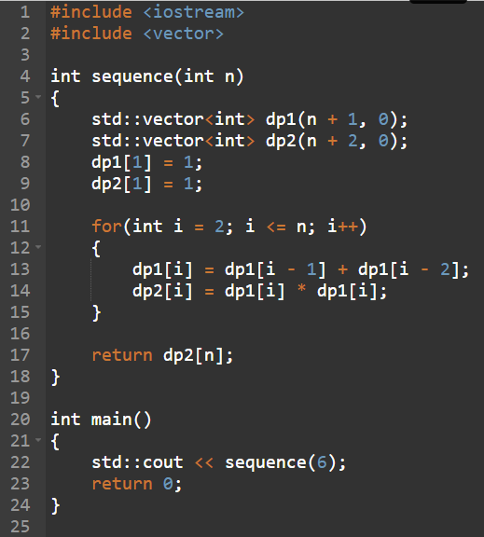
Mentimeter
Notes:
We have seen sorting already: Heap sort, inorder of trees

Slide 11
Mentimeter
 | 0 | 1 | 2 | 3 | 4 | 5 | 6 | 7
{} | 0 | 0 | 0 | 0 | 0 | 0 | 0 | 0
{1} | 0
{1, 2} | 0
{1, 2, 3} | 0
{1, 2, 3, 4} | 0
 | v_{i} | w_{i}
1 | 3 | 1
2 | 6 | 3
3 | 28 | 5
4 | 30 | 7
OPT(i, W) = {max{OPT(i-1, w), v_{i} + OPT(i-1, W-w_{i}) } otherwise
0 if i=0
OPT(i-1, w) if w_{i} > W
Notes:
We have seen sorting already: Heap sort, inorder of trees

Slide 12
Mentimeter
 | 0 | 1 | 2 | 3 | 4 | 5 | 6 | 7
{} | 0 | 0 | 0 | 0 | 0 | 0 | 0 | 0
{1} | 0 | 3 | 3 | 3 | 3 | 3 | 3 | 3
{1, 2} | 0 | 3 | 3 | 6 | 9 | 9 | 9 | 9
{1, 2, 3} | 0 | 3 | 3 | 6 | 9 | 28 | 31 | 31
{1, 2, 3, 4} | 0 | 3 | 3 | 6 | 9 | 28 | 31 | 31
 | v_{i} | w_{i}
1 | 3 | 1
2 | 6 | 3
3 | 28 | 5
4 | 30 | 7
OPT(i, W) = {max{OPT(i-1, w), v_{i} + OPT(i-1, W-w_{i}) } otherwise
0 if i=0
OPT(i-1, w) if w_{i} > W
Notes:
We have seen sorting already: Heap sort, inorder of trees

Slide 13
Common Representations
Edge List
Adjacency Matrix
Adjacency List
60
D
80
B
F
10
40
A
50
E
15
C
5
G
Notes:
For any possible way of organizing data, we must think about cost;
minimize time cost of most frequent operations;
Lets say we have a social network, we might need to find If a is friends with B

Slide 14
Edge List
A | B | 10
A | C | 15
B | D | 60
D | C | 40
D | F | 80
E | F | 50
C | E | 5
60
D
80
B
F
10
40
A
50
E
15
C
5
G
G = {(A,B), (A,C), (B,D), (D,C), (D,F), (E,F), (C,E)}
Notes:
For any possible way of organizing data, we must think about cost;
minimize time cost of most frequent operations;
Lets say we have a social network, we might need to find If a is friends with B

Slide 15
Edge List
Common Operations:
Connectedness
Adjacency
Space: O(E)
60
D
80
B
F
Is A connected to B?
10
40
~ O(E)
A
50
E
15
C
5
A | B | 10
A | C | 15
B | D | 60
D | C | 40
D | F | 80
E | F | 50
C | E | 5
What are A’s adjacent nodes?
G = {(A,B), (A,C), (B,D), (D,C), (D,F), (E,F), (C,E)}
~ O(E)
G
O(|E|) ~ O(|V| * |V|)

Slide 16
Adjacency Matrix
A B C D E F
A
B
C
D
E
F
0 | 10 | 15 | 0 | 0 | 0
0 | 0 | 0 | 60 | 0 | 0
0 | 0 | 0 | 0 | 5 | 0
0 | 0 | 40 | 0 | 0 | 80
0 | 0 | 0 | 0 | 0 | 50
0 | 0 | 0 | 0 | 0 | 0
60
D
80
B
F
10
40
A
50
E
15
C
5
Insertion:
G[from][to] = weight; (if there is an edge, “from” -> “to”)
G[from][to] = 0; (otherwise)
G
Notes:
For any possible way of organizing data, we must think about cost;
minimize time cost of most frequent operations;
Lets say we have a social network, we might need to find If a is friends with B

Slide 17
Adjacency Matrix Implementation
Insertion:
G[from][to] = weight; (if there is an edge, “from” -> “to”)
G[from][to] = 0; (otherwise)
60
D
80
B
F
01 02 03 04 05 06 07 08 09 10 11 12 13 14 15 16 17 18 19 20 21 22
#include <iostream> #include<map> #define VERTICES 6 using namespace std; int main() { int no_lines, wt, j=0; string from, to; int graph [VERTICES][VERTICES] = {0}; map<string, int> mapper; cin >> no_lines; for(int i = 0; i < no_lines; i++) { cin >> from >> to >> wt; if (mapper.find(from) == mapper.end()) mapper[from] = j++; if (mapper.find(to) == mapper.end()) mapper[to] = j++; graph[mapper[from]][mapper[to]] = wt; } return 0; }
10
40
A
50
E
15
C
5
Input
7
A B 10
A C 15
B D 60
D C 40
C E 5
D F 80
E F 50
0 1 2 3 4 5
G
Map
A 0
B 1
C 2
D 3
E 4
F 5
0 | 10 | 15 | 0 | 0 | 0
0 | 0 | 0 | 60 | 0 | 0
0 | 0 | 0 | 0 | 5 | 0
0 | 0 | 40 | 0 | 0 | 80
0 | 0 | 0 | 0 | 0 | 50
0 | 0 | 0 | 0 | 0 | 0
0
1
2
3
4
5
https://www.onlinegdb.com/Hy8M0CnsS
Notes:
For any possible way of organizing data, we must think about cost;
minimize time cost of most frequent operations;
Lets say we have a social network, we might need to find If a is friends with B

Slide 18
Adjacency Matrix
Common Operations:
Connectedness
Adjacency
Space: O(|V| * |V|)
60
D
80
B
F
Is A connected to B?
10
40
G[“A”][“B”] ~ O(1)
A
50
E
15
C
5
What are A’s adjacent nodes?
G
0 1 2 3 4 5
for each element x in G[“A”]
if x ! = 0
~ O(|V|)
Map
A 0
B 1
C 2
D 3
E 4
F 5
0
1
2
3
4
5
0 | 10 | 15 | 0 | 0 | 0
0 | 0 | 0 | 60 | 0 | 0
0 | 0 | 0 | 0 | 5 | 0
0 | 0 | 40 | 0 | 0 | 80
0 | 0 | 0 | 0 | 0 | 50
0 | 0 | 0 | 0 | 0 | 0

Slide 19
Adjacency List
Common Operations:
Connectedness
Adjacency
Space: O(|V| + |E|)
60
D
80
B
F
Is A connected to B?
10
40
for each element x in G[“A”]
if x ! = ‘B’
~ O(outdegree|V|)
A
50
E
15
C
5
What are A’s adjacent nodes?
G
A | B | 10 |  | C | 15
B | D | 60
C | E | 5
D | C | 40 |  | F | 80
E | F | 50
F
G[“A”] ~ O(outdegree|V|)
Sparse Graph: Edges ~ Vertices
Notes:
Can perform binary search

Slide 20
Adjacency List Implementation
Insertion:
If to or from vertex not present add vertex
Otherwise add edge at the end of the list
60
D
80
B
F
01 02 03 04 05 06 07 08 09 10 11 12 13 14 15 16 17 18 19 20
#include <iostream> #include<map> #include<vector> #include<iterator> using namespace std; int main() { int no_lines; string from, to, wt; map<string, vector<pair<string,int>>> graph; cin >> no_lines; for(int i = 0; i < no_lines; i++) { cin >> from >> to >> wt; graph[from].push_back(make_pair(to, stoi(wt))); if (graph.find(to)==graph.end()) graph[to] = {}; } }
10
40
A
50
E
15
C
5
Input
7
A B 10
A C 15
B D 60
D C 40
C E 5
D F 80
E F 50
G
A | B | 10 |  | C | 15
B | D | 60
C | E | 5
D | C | 40 |  | F | 80
E | F | 50
F
https://onlinegdb.com/HkJq9iFaI
Notes:
For any possible way of organizing data, we must think about cost;
minimize time cost of most frequent operations;
Lets say we have a social network, we might need to find If a is friends with B

Slide 21
Graph Implementation
 | Edge List | Adjacency Matrix | Adjacency List
Time Complexity: Connectedness | O(E) | O(1) | O(outdegree(V))
Time Complexity: Adjacency | O(E) | O(V) | O(outdegree(V))
Space Complexity | O(E) | O(V*V) | O(V+E)
Notes:
Hi everyone, welcome to the second module of the course

Slide 22
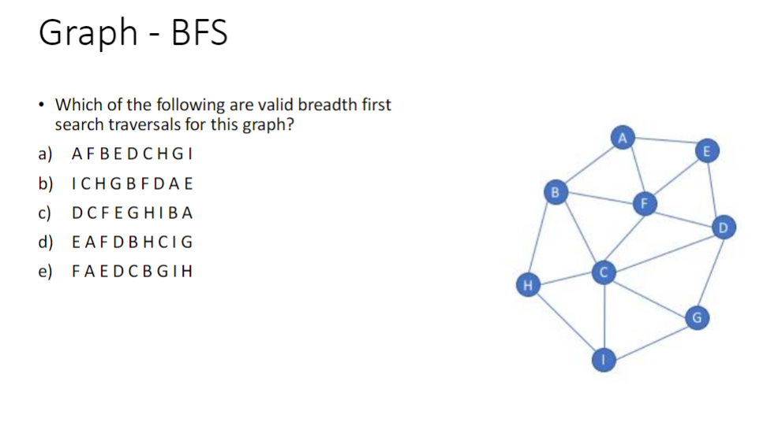
Alt Text for the Graph on Next Slide
Vertex: Neighbors of Vertex (Edges pointing from a vertex to the neighbor)
A: B, E, F
B: A, C, F, H
C: B, D, F, G, H, I
D: C, E, F, G
E: A, D, F
F: A, B, C, D, E
G: C, D, I
H: B, C, I
I: C, G, H
Notes:
In the last lecture we covered BFS and DFS and today we will continue with some applications of these traversals in common problem.

Slide 23
Notes:
In the last lecture we covered BFS and DFS and today we will continue with some applications of these traversals in common problem.

Slide 24
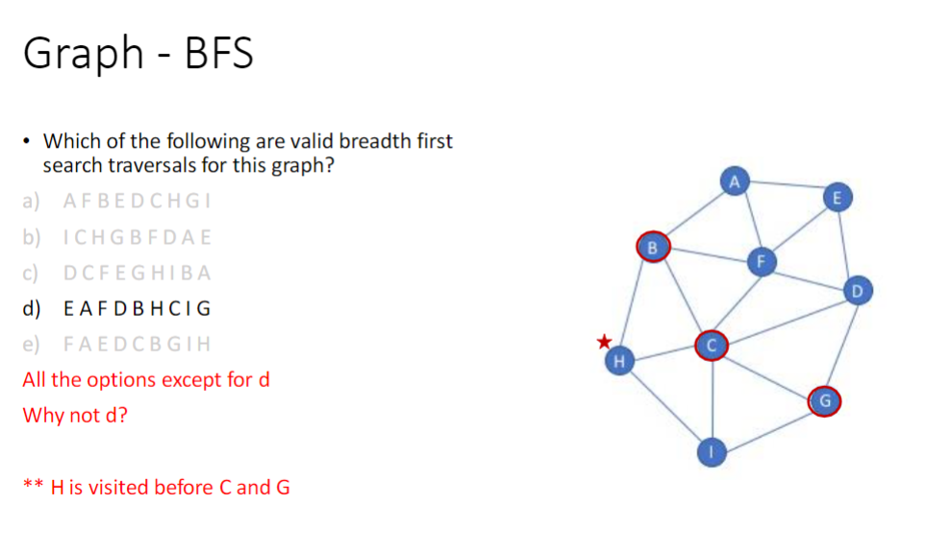
Notes:
In the last lecture we covered BFS and DFS and today we will continue with some applications of these traversals in common problem.

Slide 25
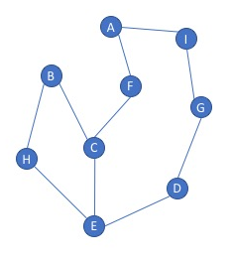
Alt Text for the Graph on Next Slide
Vertex: Neighbors of Vertex (Edges pointing from a vertex to the neighbor)
A: F, I
B: C, H
C: B, E, F
D: E, G
E: C, D, H
F: A, C
G: D, I
H: B, E
I: A, G
Notes:
In the last lecture we covered BFS and DFS and today we will continue with some applications of these traversals in common problem.

Slide 26
Valid DFS: Which DFS are valid?
H E C B D G I A F
C E H B D G I A F
A F C E H B I G D
D E C B H F A I G
Notes:
We have seen sorting already: Heap sort, inorder of trees

Slide 27
Valid DFS: Which DFS are valid?
H E C B D G I A F
C E H B D G I A F
A F C E H B I G D
D E C B H F A I G
Notes:
We have seen sorting already: Heap sort, inorder of trees

Slide 28
Applied Traversal
A connected component of a graph is a collection of vertices in which any two vertices in a component have a path between them.Given an unweighted and undirected graph represented as an adjacency list, write a function using pseudocode or C++ code which will return the number of vertices in the largest component of the graph. You do not need to write main method for reading and creating a graph. Assume that the graph is passed into your function which has the following signature:
unsigned int largest_component(unordered_map<int, vector<int>>& adjListGraph){
// code here
}
Example input:
0: 2, 3
1: 4
2: 0, 6
3: 0
4: 1, 5
5: 4
6: 2
7:
Example output: 4
Explanation: There are three connected components: (0,2,3,6); (1,4,5); and (7). Of these, the largest has 4 vertices.
Also, state the Big O complexity of the solution in the worst case.
Notes:
We have seen sorting already: Heap sort, inorder of trees

Slide 29
Applied Traversal
#include <unordered_map>
#include <vector>
#include <unordered_set>
using namespace std;
unsigned int dfs(int node, unordered_map<int, vector<int>>& adjListGraph, unordered_set<int>& visited) {
visited.insert(node);
unsigned int size = 1; // Start with the current node
for (int neighbor : adjListGraph[node]) {
if (visited.find(neighbor) == visited.end()) {
size += dfs(neighbor, adjListGraph, visited);
}
}
return size;
}
unsigned int largest_component(unordered_map<int, vector<int>>& adjListGraph) {
unordered_set<int> visited;
unsigned int maxComponentSize = 0;
for (const auto entry : adjListGraph) {
int node = entry.first;
if (visited.find(node) == visited.end()) {
unsigned int componentSize = dfs(node, adjListGraph, visited);
if (componentSize > maxComponentSize) {
maxComponentSize = componentSize;
}
}
}
return maxComponentSize;
}
Notes:
We have seen sorting already: Heap sort, inorder of trees

Slide 30
BFS vs DFS
01 02 03 04 05 06 07 08 09 10 11 12 13 14 15 16 17 18 19 20 21 22 23
string source = "A"; std::set<string> visited; std::queue<string> q; visited.insert(source); q.push(source); cout<<"BFS: "; while(!q.empty()) { string u = q.front(); cout << u; q.pop(); vector<string> neighbors = graph[u]; for(string v: neighbors) { if(visited.count(v)==0) { visited.insert(v); q.push(v); } } }
01 02 03 04 05 06 07 08 09 10 11 12 13 14 15 16 17 18 19 20 21 22 23
string source = "A"; std::set<string> visited; std::stack<string> s; visited.insert(source); s.push(source); cout<<“DFS: "; while(!q.empty()) { string u = s.top(); cout << u; s.pop(); vector<string> neighbors = graph[u]; for(string v: neighbors) { if(visited.count(v)==0) { visited.insert(v); s.push(v); } } }
Theoretical Complexity: O(V+E)
Notes:
For any possible way of organizing data, we must think about cost;
minimize time cost of most frequent operations;
Lets say we have a social network, we might need to find If a is friends with B

Slide 31
BFS Pseudocode
Write pseudocode/code for implementing the Breadth First Search Algorithm of a graph, G that takes a source vertex S as input. (8).
Also, state the Big O complexity of the traversal in the worst case (2).
Notes:
We have seen sorting already: Heap sort, inorder of trees

Slide 32
Graph Algorithm Mix n Match
Finds the shortest paths in a weighted graph
Find the minimum cost connected network
Scheduling algorithm, list steps in a process
Finds the shortest path in an unweighted graph
Prim’s or Kruskals
BFS
DFS
Topological Sort
Dijkstra’s Algorithm
Notes:
For any possible way of organizing data, we must think about cost;
minimize time cost of most frequent operations;
Lets say we have a social network, we might need to find If a is friends with B

Slide 33
Graph Algorithm Mix n Match
Finds the shortest paths in a weighted graph
Find the minimum cost connected network
Scheduling algorithm, list steps in a process
Finds the shortest path in an unweighted graph
Prim’s or Kruskals
BFS
DFS
Topological Sort
Dijkstra’s Algorithm
Notes:
For any possible way of organizing data, we must think about cost;
minimize time cost of most frequent operations;
Lets say we have a social network, we might need to find If a is friends with B

Slide 34
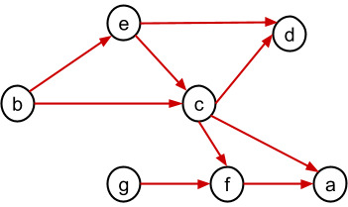
Alt Text for the Graph on Next Slide
Vertex: Neighbors of Vertex (Edges pointing from a vertex to the neighbor)
A: -
B: C, E
C: A, D, F
D: -
E: C, D
F: A
G: F
Notes:
In the last lecture we covered BFS and DFS and today we will continue with some applications of these traversals in common problem.

Slide 35
Which of the choices below represent a valid topological sort ordering of this graph?
b, e, c, g, f, a, d
b, a, c, g, f, e, d
b, g, f, c, e, a, d
b, e, c, g, a, f, d
b, g, e, c, d, f, a
b, f, c, g, a, e, d
Notes:
In the last lecture we covered BFS and DFS and today we will continue with some applications of these traversals in common problem.

Slide 36
Which of the choices below represent a valid topological sort ordering of this graph?
b, e, c, g, f, a, d
b, a, c, g, f, e, d
b, g, f, c, e, a, d
b, e, c, g, a, f, d
b, g, e, c, d, f, a
b, f, c, g, a, e, d
Notes:
In the last lecture we covered BFS and DFS and today we will continue with some applications of these traversals in common problem.

Slide 37
What does this code do?
#include <set>
#include <stack>
using namespace std;
bool doSomething(const Graph& graph, int src, int dest)
{
set<int> visited;
stack<int> s;
visited.insert(src);
s.push(src);
while(!s.empty())
{
int u = s.top();
s.pop();
for(auto v: graph.adjList[u])
{
if(v == dest)
return true;
if ((visited.find(v) == visited.end())) {
visited.insert(v);
s.push(v);
}
}
}
return false;
}
Notes:
For any possible way of organizing data, we must think about cost;
minimize time cost of most frequent operations;
Lets say we have a social network, we might need to find If a is friends with B

Slide 38
What does this code do?
#include <set>
#include <stack>
using namespace std;
bool doSomething(const Graph& graph, int src, int dest)
{
set<int> visited;
stack<int> s;
visited.insert(src);
s.push(src);
while(!s.empty())
{
int u = s.top();
s.pop();
for(auto v: graph.adjList[u])
{
if(v == dest)
return true;
if ((visited.find(v) == visited.end())) {
visited.insert(v);
s.push(v);
}
}
}
return false;
}
Returns whether a given vertex is reachable from another vertex using DFS
Notes:
For any possible way of organizing data, we must think about cost;
minimize time cost of most frequent operations;
Lets say we have a social network, we might need to find If a is friends with B

Slide 39
Scenario
A county government maintains a network of roads. The county government has tabulated the cost of maintaining each road. They need to minimize the cost of road maintenance but ensure that all places in the county are accessible.
Which graph algorithm that we discussed in class could they use to solve this problem? What are the vertices, what are the edges, what are the edge values?
Notes:
We have seen sorting already: Heap sort, inorder of trees

Slide 40
Scenario
A county government maintains a network of roads. The county government has tabulated the cost of maintaining each road. They need to minimize the cost of road maintenance but ensure that all places in the county are accessible.
Which graph algorithm that we discussed in class could they use to solve this problem? What are the vertices, what are the edges, what are the edge values?
Prim's or Kruskals algorithm for minimum spanning tree.
Roads are edges.
Ends of roads are vertices.
Edge weights are cost for maintaining roads.
Notes:
We have seen sorting already: Heap sort, inorder of trees

Slide 41
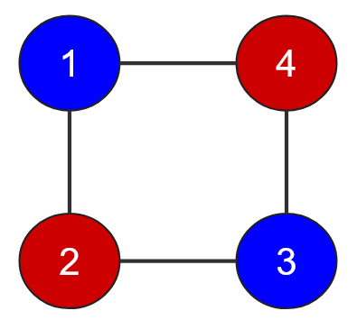
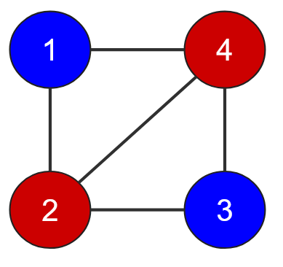
Scenario
A bipartite graph is known formally as an undirected graph whose nodes can be grouped into two sets such that no edge connects a node to another node in its own set (that is, every edge connects a node from one set to another). If the following graphs are colored using two colors denoting different sets, are these graphs bipartite?
Graph 1
Graph 2
Notes:
We have seen sorting already: Heap sort, inorder of trees

Slide 42
Scenario
A bipartite graph is known formally as an undirected graph whose nodes can be grouped into two sets such that no edge connects a node to another node in its own set (that is, every edge connects a node from one set to another). If the following graphs are colored using two colors denoting different sets, are these graphs bipartite?
Graph 1
Graph 2
Bipartite
Non-Bipartite (Edge 2-4) in the same set
Notes:
We have seen sorting already: Heap sort, inorder of trees

Slide 43
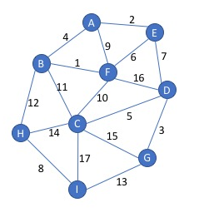
Alt Text for the Graph on Next Slide
Vertex: <Neighbors of Vertex (Edges pointing from a vertex to the neighbor), edge weight>
A: <B, 4>, <E, 2>, <F, 9>
B: <A, 4>, <C, 11>, <F, 1>, <H, 12>
C: <B, 11>, <D, 7>, <F, 10>, <G, 15>, <H, 14>, <I, 17>
D: <C, 5>, <E, 7>, <F, 16>, <G, 3>
E: <A, 2>, <D, 7>, <F, 6>
F: <A, 9>, <B, 1>, <C, 10>, <D, 16>, <E, 6>
G: <C, 15>, <D, 3>, <I, 13>
H: <B, 12>, <C, 14>, <I, 8>
I: <C, 17>, <G, 13>, <H, 8>
Notes:
In the last lecture we covered BFS and DFS and today we will continue with some applications of these traversals in common problem.

Slide 44
MST using Prims starting from “I”
Notes:
We have seen sorting already: Heap sort, inorder of trees

Slide 45
MST using Prims starting from “I”
I H B F A E D G C
Notes:
We have seen sorting already: Heap sort, inorder of trees

Slide 46
Alt Text for the Graph on Next Slide
Vertex: <Neighbors of Vertex (Edges pointing from a vertex to the neighbor), edge weight>
A: <B, 1>, <D, 3>, <F, 2>
B: <A, 1>, <C, 2>, <D, 1>, <E, 7>
C: <B, 2>, <D, 6>, <E, 10>
D: <A, 3>, <B, 1>, <C, 6>, <F, 4>, <G, 4>
E: <B, 7>, <C, 10>
F: <A, 2>, <D, 4>, <G, 10>
G: <D, 4>, <F, 10>
A
2
1
F
3
B
4
7
1
10
D
2
E
4
6
G
C
10
Notes:
In the last lecture we covered BFS and DFS and today we will continue with some applications of these traversals in common problem.

Slide 47
Dijkstra with A as source
A
2
1
F
3
B
4
7
v | D(v) | P(v)
A
B
C
D
E
F
G
1
10
D
2
E
4
6
G
C
10
Notes:
We have seen sorting already: Heap sort, inorder of trees

Slide 48




Dijkstra with A as source
A
2
1
F
3
B
4
7
v | D(v) | P(v)
A | 0 | NA
B |  | A
C |  | B
D | 2 | B
E |  | B
F | 2 | A
G |  | D
1
10
D
2
E
4
6
$$1$$
G
C
10
$$3$$
$$8$$
$$6$$
Notes:
We have seen sorting already: Heap sort, inorder of trees

Slide 49
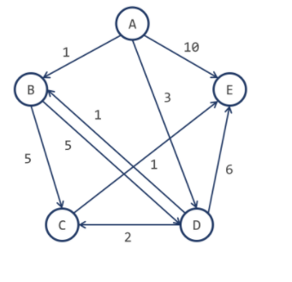
Alt Text for the Graph on Next Slide
Vertex: <Neighbors of Vertex (Edges pointing from a vertex to the neighbor), edge weight>
A: <B, 1>, <D, 3>, <E, 10>
B: <C, 5>, <D, 5>
C: <E, 1>
D: <B, 1>, <C, 2>, <E, 6>
E: -
Notes:
In the last lecture we covered BFS and DFS and today we will continue with some applications of these traversals in common problem.

Slide 50
Dijkstra with A as source
V d(V) p(V)
B
C
D
E
Notes:
We have seen sorting already: Heap sort, inorder of trees

Slide 51
Dijkstra with A as source
V d(V) p(V)
B 1 A
C 5 D
D 3 A
E 6 C
Notes:
We have seen sorting already: Heap sort, inorder of trees

Slide 52
Algorithmic Paradigms
Notes:
Hi everyone, welcome to the second module of the course

Slide 53
Algorithmic Paradigms
 | Properties | Examples
Brute Force | Generate and Test an Exhaustive Set of all possible combinations Can be computationally very expensive Guarantees optimal solution | Finding divisors of a number, n by checking if all numbers from 1..n divides n without remainder Finding duplicates using all combinations Bubble/Selection Sort
Divide and Conquer | Break the problem into subcomponents typically using recursion Solve the basic component Combine the solutions to sub-problems | Quick Sort Merge Sort Binary Search Peak Finding
Dynamic Programming | Optimal substructure: solution to a large problem can be obtained by solution to a smaller optimal problems Overlapping sub-problems: space of sub-problems must be small, that is, any recursive algorithm solving the problem should solve the same sub-problems over and over, rather than generating new sub-problems. Guarantees optimal solution | Fibonacci Sequence Assembly Scheduling Knapsack
Greedy Algorithms | Local optimal solutions at each stage Does not guarantee optimal solution | Prim’s Algorithm Dijkstra’s Algorithm Kruskal’s Algorithm
Notes:
Memoization –top down, call stack avoids some problems
Tabulation bottom up all subproblems
32 – 14, 8, 1

Slide 54
Bin Packing
If we have packets that each require 7 units, 8 units, 2 units and 3 units of space, how many minimum bins are required to store all the four packets if each bin can take at most 10 units of space using the following Greedy strategies
First Fit: scan the bins and place the new item in the first bin that is large enough.
Best Fit: scan the bins and place the new item in the bin that finds the spot that creates the smallest empty space
Notes:
In the last lecture we covered BFS and DFS and today we will continue with some applications of these traversals in common problem.

Slide 55
Algorithm for Huffman Encoding
Given this file, generate a Huffman Tree and identify the codes of each character.
care racecar era
Use the following constraints when building the tree:
the node with a lower frequency is attached to the left in case two nodes are merged after extraction from the priority queue;
if two nodes have the same priority when merging, then the merged nodes are resolved as follows:
if both nodes have letters (a.k.a. left nodes) then the letter with lower ascii value will be the left node when combining two nodes into a tree.
if one or both nodes have cumulative frequencies, then the node with more number of nodes in the tree will be attached to the right, in other words, the smaller tree will be towards the left.
traversing left from a node appends '0' to the Huffman code and traversing right appends '1'.
Notes:
In the last lecture we covered BFS and DFS and today we will continue with some applications of these traversals in common problem.

Slide 56
Algorithm for Huffman Encoding
1. Create a table with symbols and their frequencies
2. Construct a set of trees with root nodes that contain each of the individual
symbols and their weight (frequency).
3. Place the set of trees into a min priority queue.
4. while the priority queue has more than one item
Remove the two trees with the smallest weights.
Combine them into a new binary tree in which the weight of the tree
root is the sum of the weights of its children.
Insert the newly created tree back into the priority queue.
5. Traverse the resulting tree to obtain binary codes for characters
Notes:
In the last lecture we covered BFS and DFS and today we will continue with some applications of these traversals in common problem.

Slide 57
Algorithm for Huffman Encoding
1. Create a table with symbols and their frequencies
care racecar era
Character | Frequency
a | 4
r | 4
c | 3
e | 3
‘ ’ | 2
Notes:
In the last lecture we covered BFS and DFS and today we will continue with some applications of these traversals in common problem.

Slide 58
Algorithm for Huffman Encoding
2. Construct a set of trees with root nodes that contain each of the individual
symbols and their weight (frequency).
3. Place the set of trees into a min priority queue.
Character | Frequency
a | 4
r | 4
c | 3
e | 3
‘ ’ | 2
‘ ’:2
c:3
e:3
a:4
r:4
Notes:
In the last lecture we covered BFS and DFS and today we will continue with some applications of these traversals in common problem.

Slide 59
Algorithm for Huffman Encoding
2. Construct a set of trees with root nodes that contain each of the individual
symbols and their weight (frequency).
3. Place the set of trees into a min priority queue.
Character | Frequency
a | 4
r | 4
c | 3
e | 3
‘ ’ | 2
e:3
a:4
r:4
5
‘ ’:2
c:3
Notes:
In the last lecture we covered BFS and DFS and today we will continue with some applications of these traversals in common problem.

Slide 60
Algorithm for Huffman Encoding
2. Construct a set of trees with root nodes that contain each of the individual
symbols and their weight (frequency).
3. Place the set of trees into a min priority queue.
Character | Frequency
a | 4
r | 4
c | 3
e | 3
‘ ’ | 2
r:4
5
7
‘ ’:2
c:3
e:3
a:4
Notes:
In the last lecture we covered BFS and DFS and today we will continue with some applications of these traversals in common problem.

Slide 61
Algorithm for Huffman Encoding
2. Construct a set of trees with root nodes that contain each of the individual
symbols and their weight (frequency).
3. Place the set of trees into a min priority queue.
Character | Frequency
a | 4
r | 4
c | 3
e | 3
‘ ’ | 2
7
9
r:4
5
e:3
a:4
‘ ’:2
c:3
Notes:
In the last lecture we covered BFS and DFS and today we will continue with some applications of these traversals in common problem.

Slide 62
Algorithm for Huffman Encoding
4. while the priority queue has more than one item
Remove the two trees with the smallest weights.
Combine them into a new binary tree in which the weight of the tree
root is the sum of the weights of its children.
Insert the newly created tree back into the priority queue.
16
Character | Frequency
a | 4
r | 4
c | 3
e | 3
‘ ’ | 2
7
9
e:3
a:4
r:4
5
‘ ’:2
c:3
Notes:
In the last lecture we covered BFS and DFS and today we will continue with some applications of these traversals in common problem.

Slide 63
Algorithm for Huffman Encoding
4. while the priority queue has more than one item
Remove the two trees with the smallest weights.
Combine them into a new binary tree in which the weight of the tree
root is the sum of the weights of its children.
Insert the newly created tree back into the priority queue.
16
Character | Frequency | Huffman Code
a | 4 | 01
r | 4 | 10
c | 3 | 111
e | 3 | 00
‘ ’ | 2 | 110
7
9
e:3
a:4
r:4
5
‘ ’:2
c:3
Notes:
In the last lecture we covered BFS and DFS and today we will continue with some applications of these traversals in common problem.

Slide 64
Questions
Notes:
In an undirected graph a cycle must contain at least three distinct vertices

Slide 65
Binary Heap
Heap Representation
int Heap[];
8
29
For a node at position p, L. child position: 2p + 1
R. child position: 2p + 2
18
29
39
66
20
66
20
28
28
37
37
26
26
76
76
32
32
74
74
89
89
A node at position c can find its parent at floor((c – 1)/2)
0
1
2
3
4
5
6
7
8
9
10
11
12
13
8
18
29
20
28
39
66
37
26
76
32
74
89
Notes:
Data structures are ways to collect data. There are basic categories of data structures:

Slide 66

Binary Heap Insertion
Heap Insertion
8
29
18
29
39
66
20
66
20
28
28
37
37
26
26
76
76
32
32
74
74
89
89
Notes:
Data structures are ways to collect data. There are basic categories of data structures:

Slide 67
Binary Heap Insertion
Heap Insertion
Insert the new element at the end of the array and set child to arr.size() – 1
Set parent to (child – 1)/ 2
while (parent >= 0 and arr[parent] > arr[child])
Swap arr[parent] and arr[child]
Set child equal to parent
Set parent equal to (child-1)/2
8
29
18
29
39
66
20
66
20
28
28
37
37
26
26
76
76
32
32
74
74
89
89
insert 11
0
1
2
3
4
5
6
7
8
9
10
11
12
13
8
18
29
20
28
39
66
37
26
76
32
74
89
Notes:
Data structures are ways to collect data. There are basic categories of data structures:

Slide 68
Binary Heap Insertion
Heap Insertion
Insert the new element at the end of the array and set child to arr.size() – 1
Set parent to (child – 1)/ 2
while (parent >= 0 and arr[parent] > arr[child])
Swap arr[parent] and arr[child]
Set child equal to parent
Set parent equal to (child-1)/2
8
18
11
20
39
29
20
28
28
37
66
child = 13 | 6 | 2
parent = 6 | 2 | 0
37
26
26
76
76
32
32
74
74
89
89
O(log n) time to insert!
Notes:
Data structures are ways to collect data. There are basic categories of data structures:

Slide 69
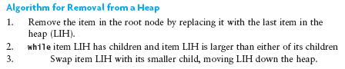
Binary MinHeap Deletion
Heap Deletion (ExtractMin)
8
18
11
20
39
29
20
28
28
37
66
37
26
26
76
76
32
32
74
74
89
89
Notes:
Data structures are ways to collect data. There are basic categories of data structures:

Slide 70
Binary MinHeap Deletion
Heap Deletion (ExtractMin)
Copy last element to root and delete last element
Heapify down
8
66
11
Heapify down
18
11
18
11
18
66
20
39
29
20
28
20
39
29
28
20
28
28
20
39
29
20
28
28
66
37
37
26
26
76
76
32
32
74
74
89
37
89
37
26
26
76
76
32
32
74
74
89
89
37
37
26
26
76
76
32
32
74
74
89
89
Notes:
Data structures are ways to collect data. There are basic categories of data structures:

Slide 71
Binary MinHeap Deletion
Heap Deletion (ExtractMin)
11
18
29
20
39
66
20
28
28
37
37
26
26
76
76
32
32
74
74
89
89
O(log n) time to ExtractMin!
Notes:
Data structures are ways to collect data. There are basic categories of data structures:

